Slide 1

Awards Ceremony

Slide 2
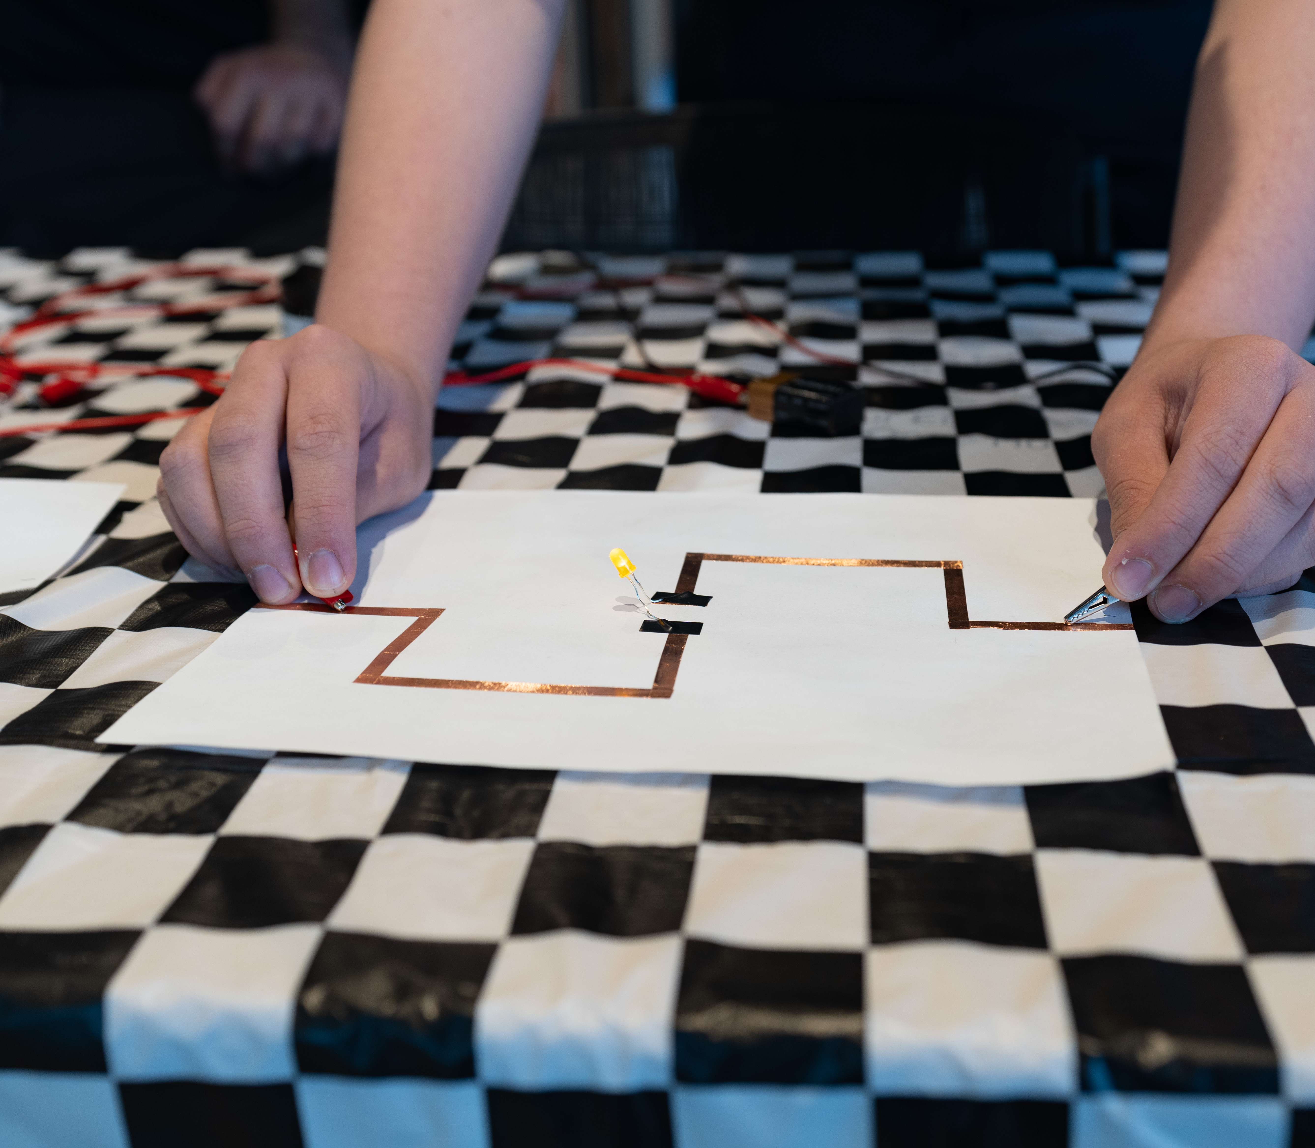
Startup Showcase

Slide 3

Winner
Nephra

Slide 4
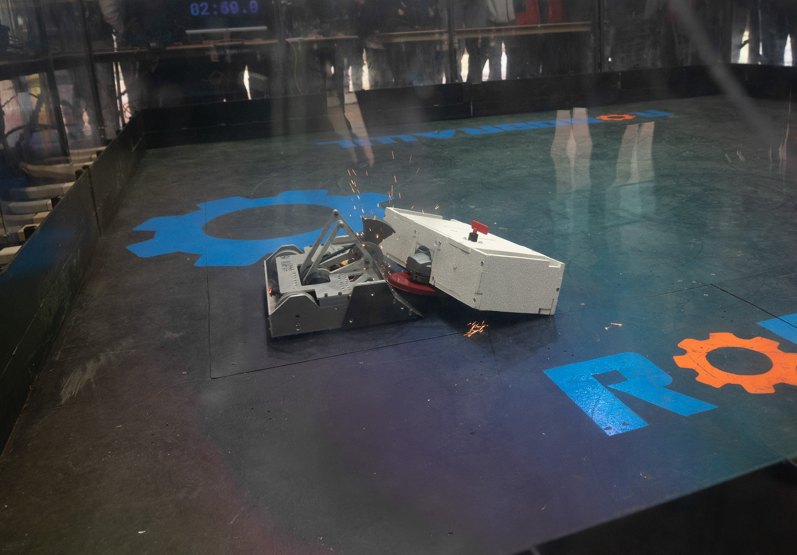
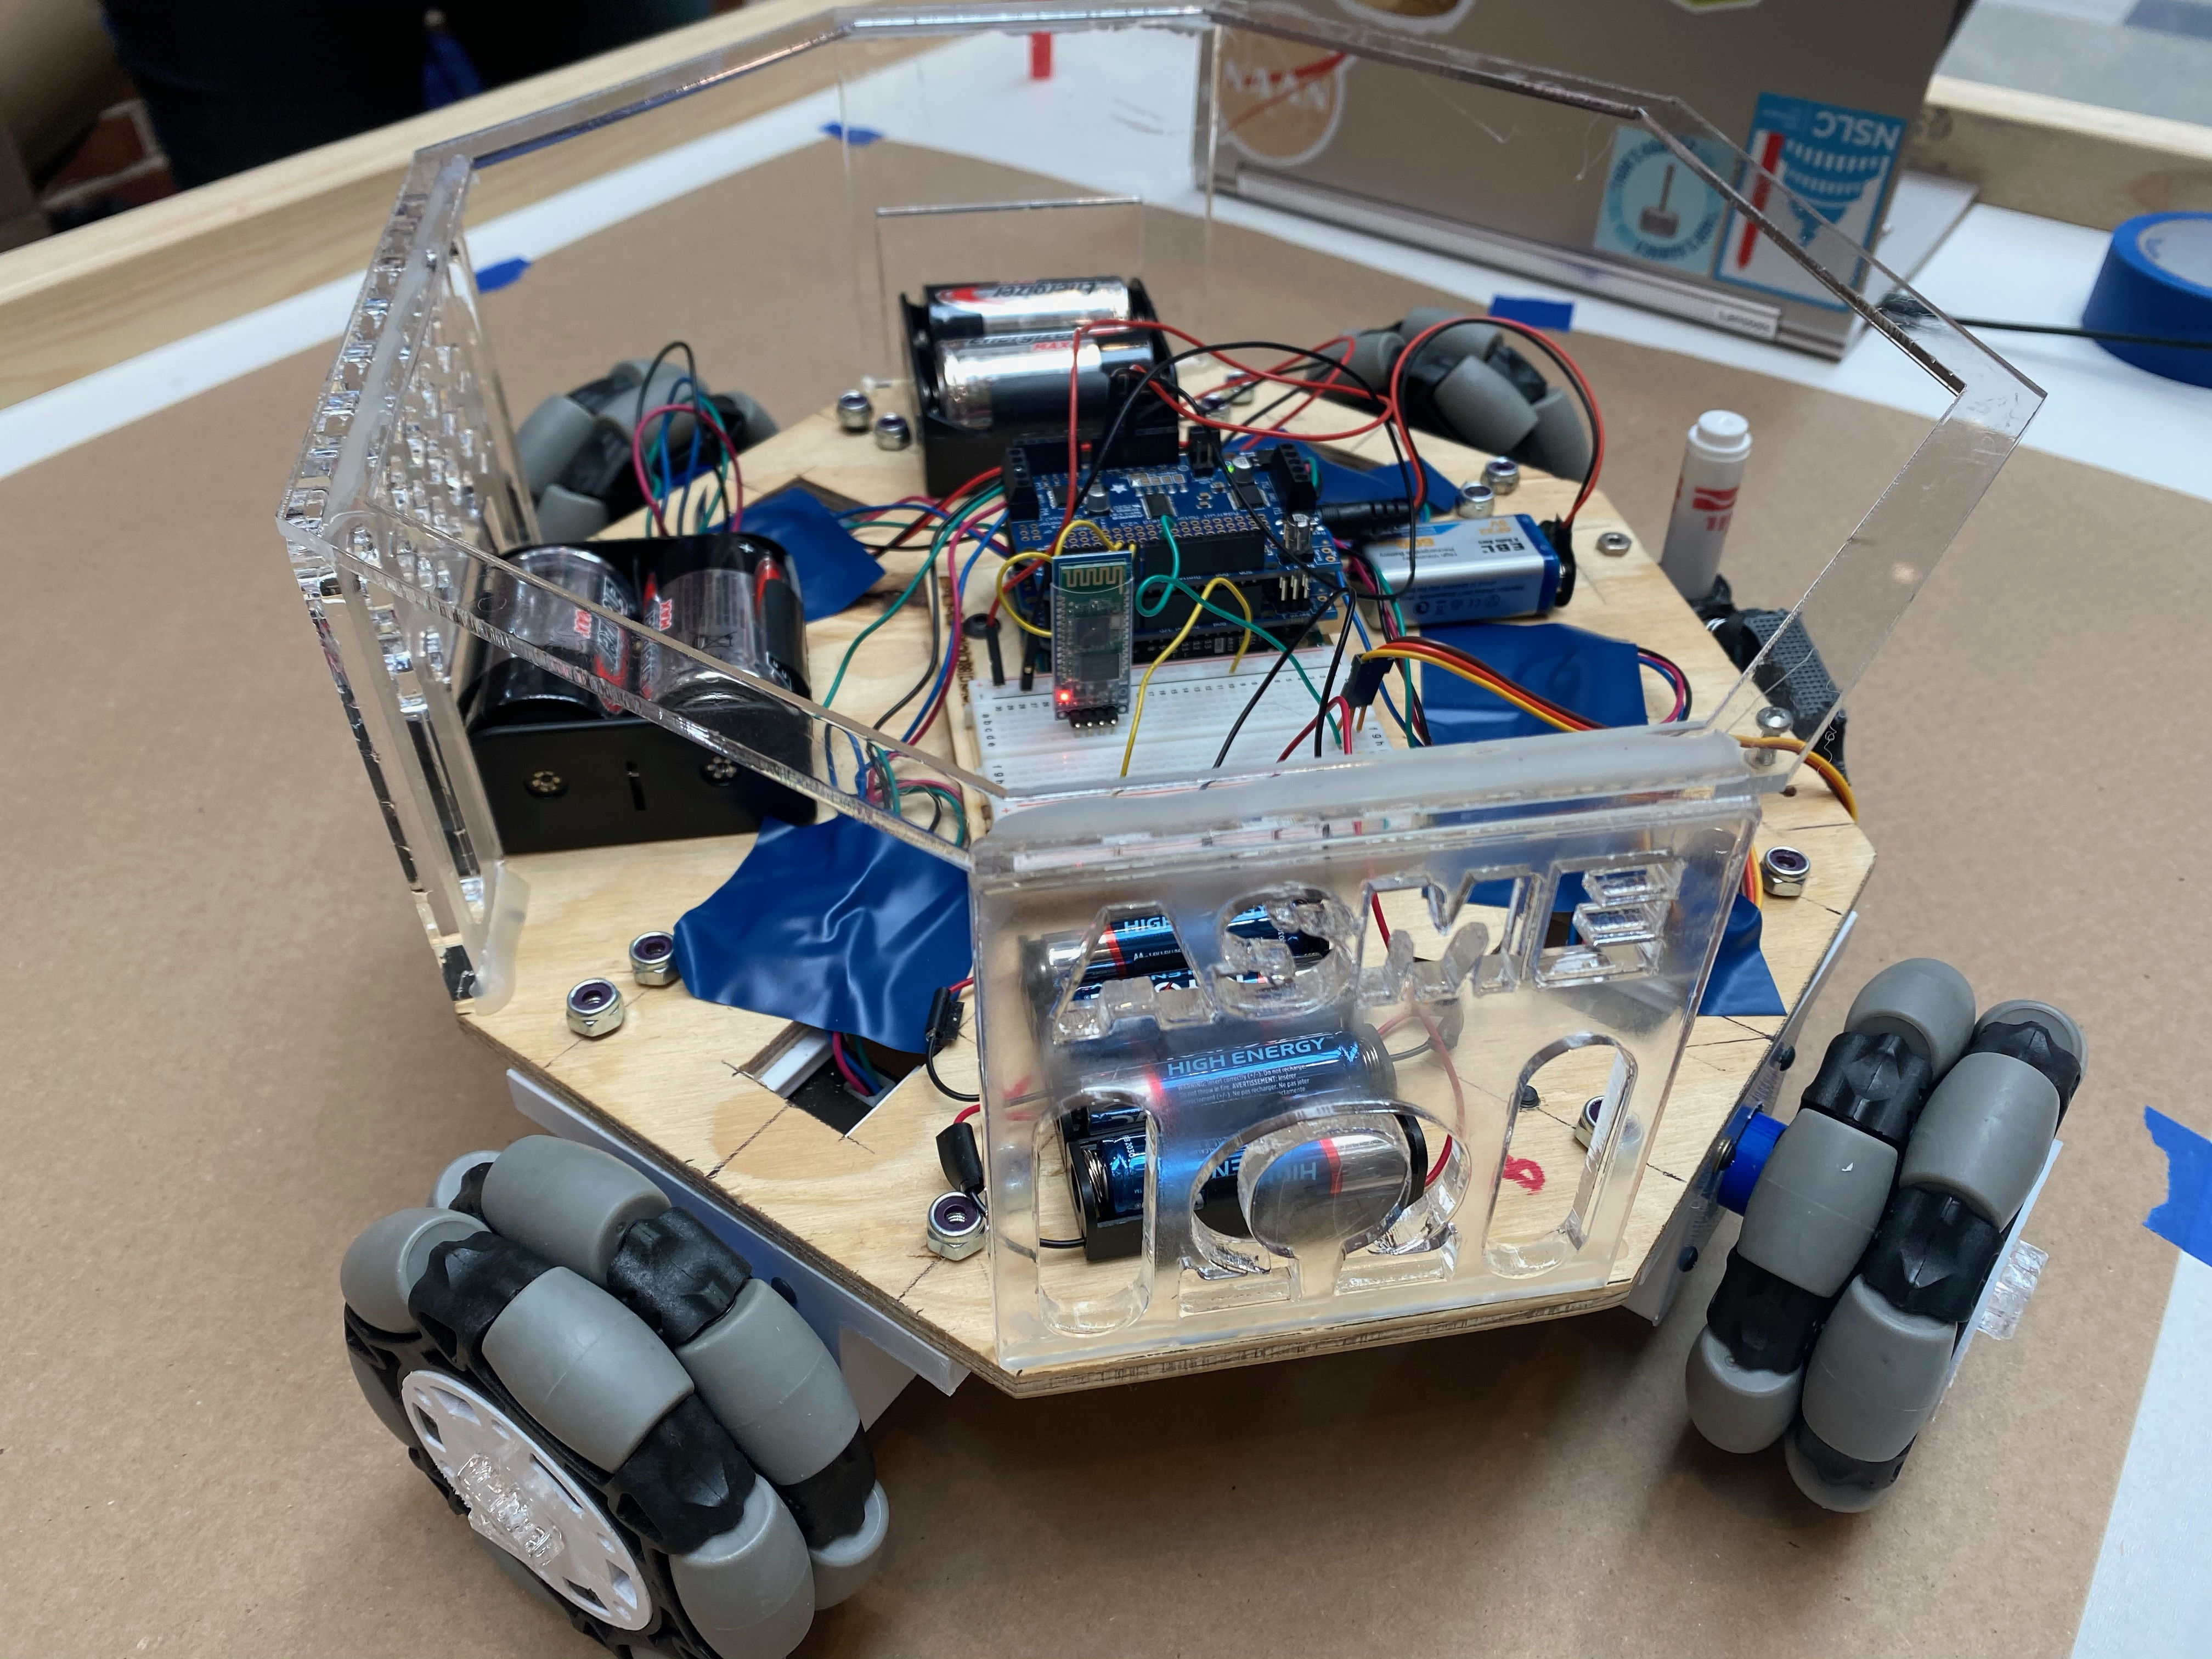
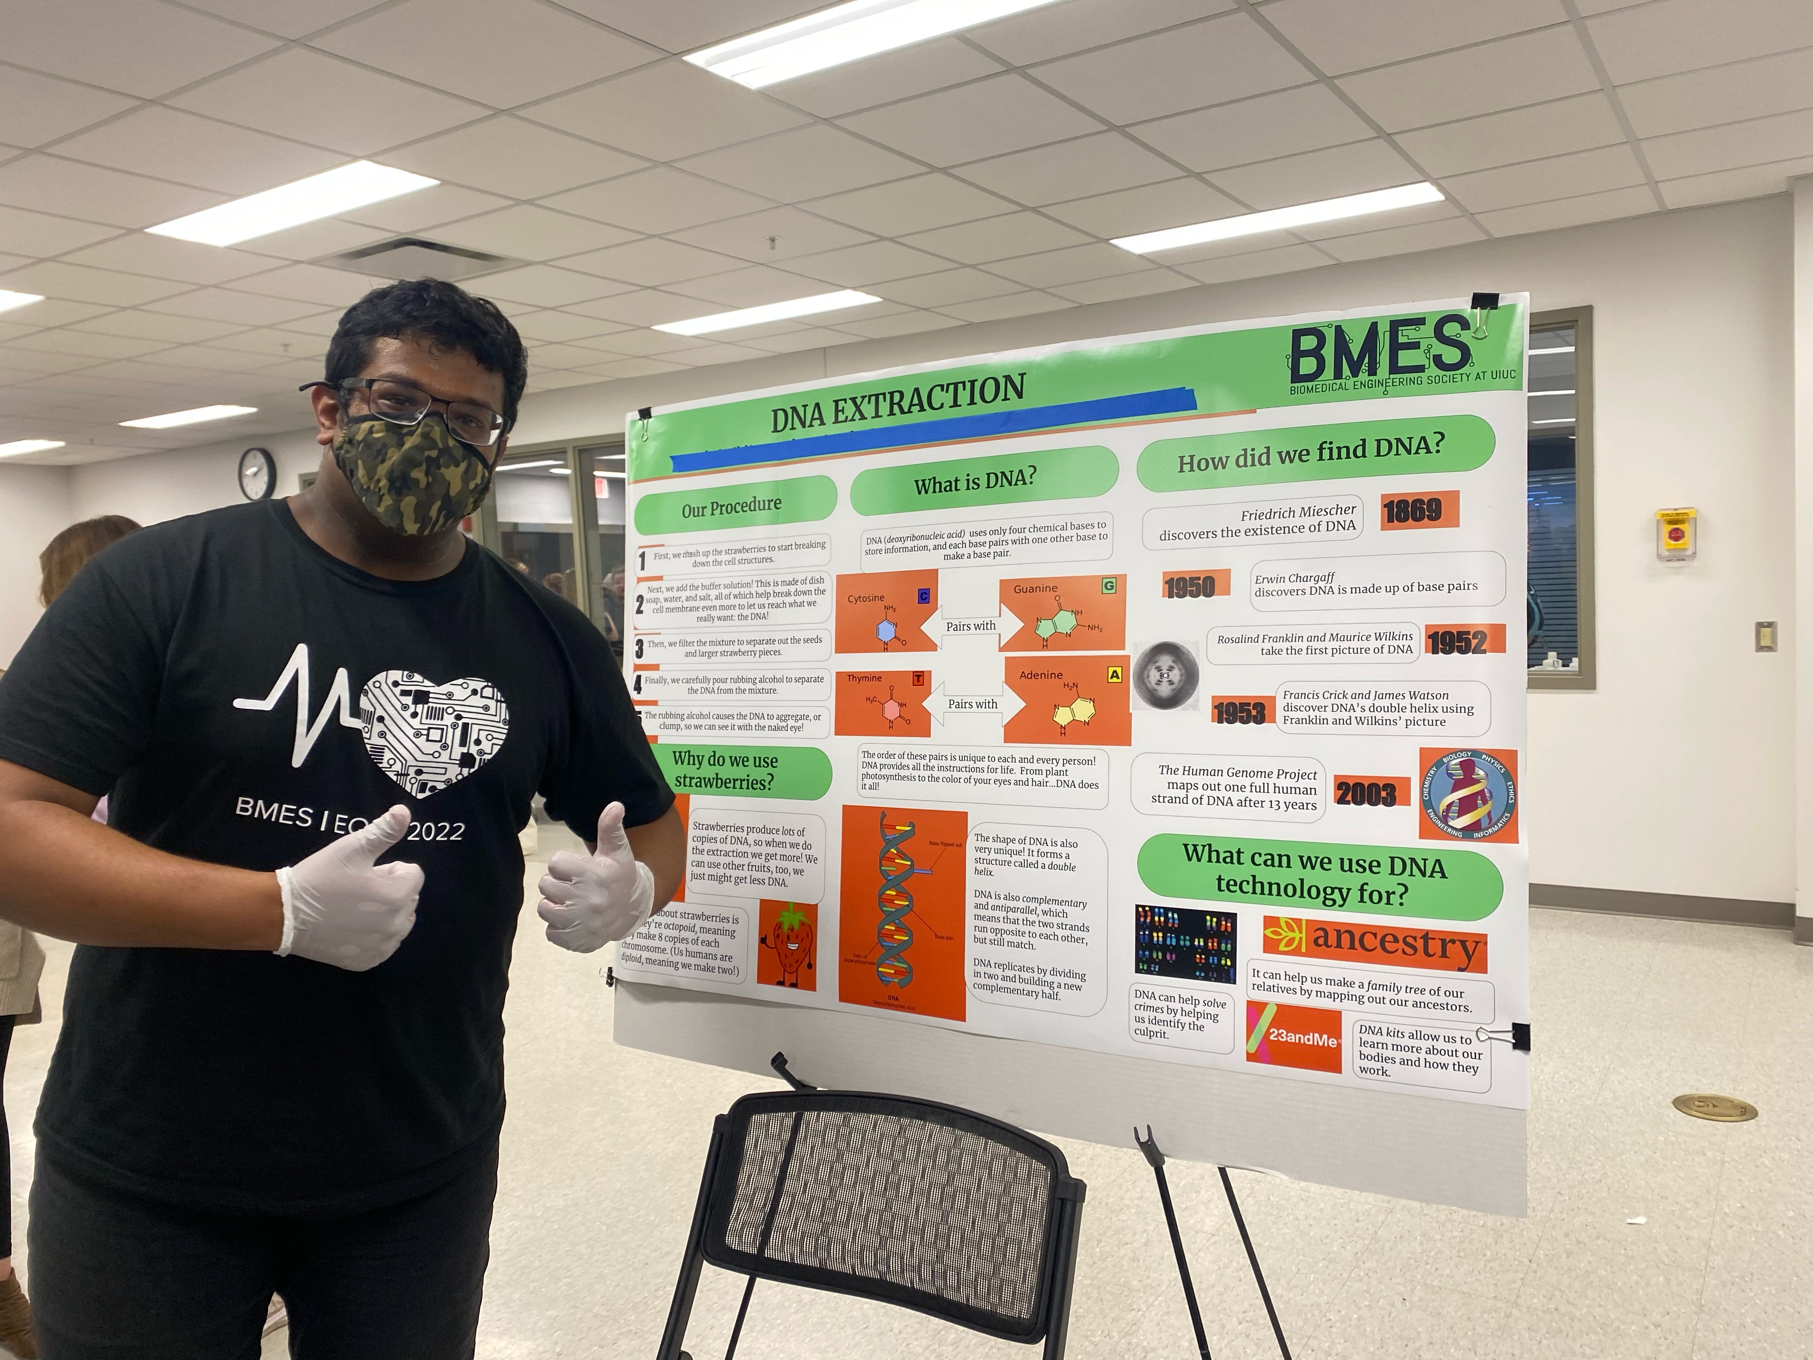
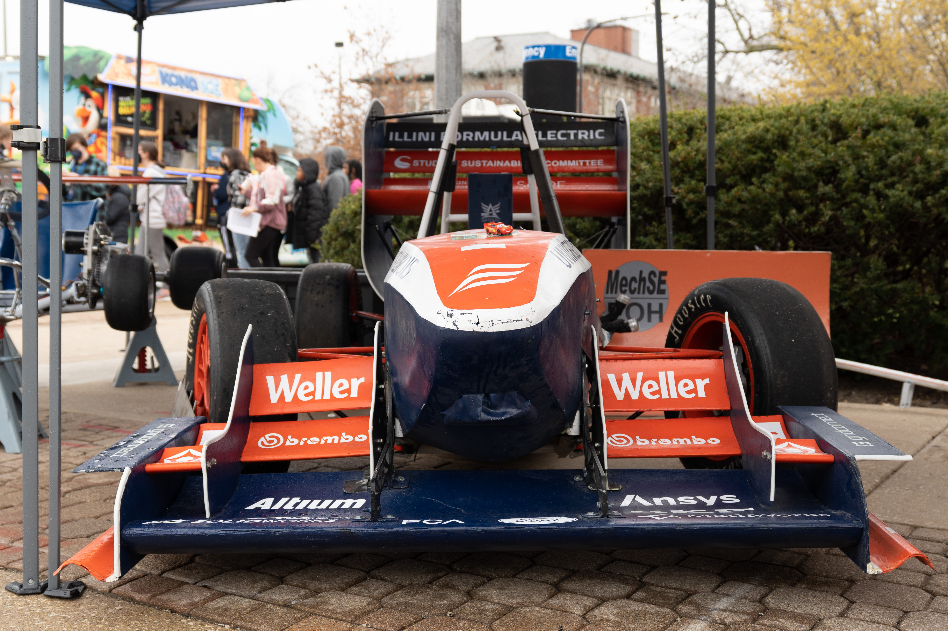
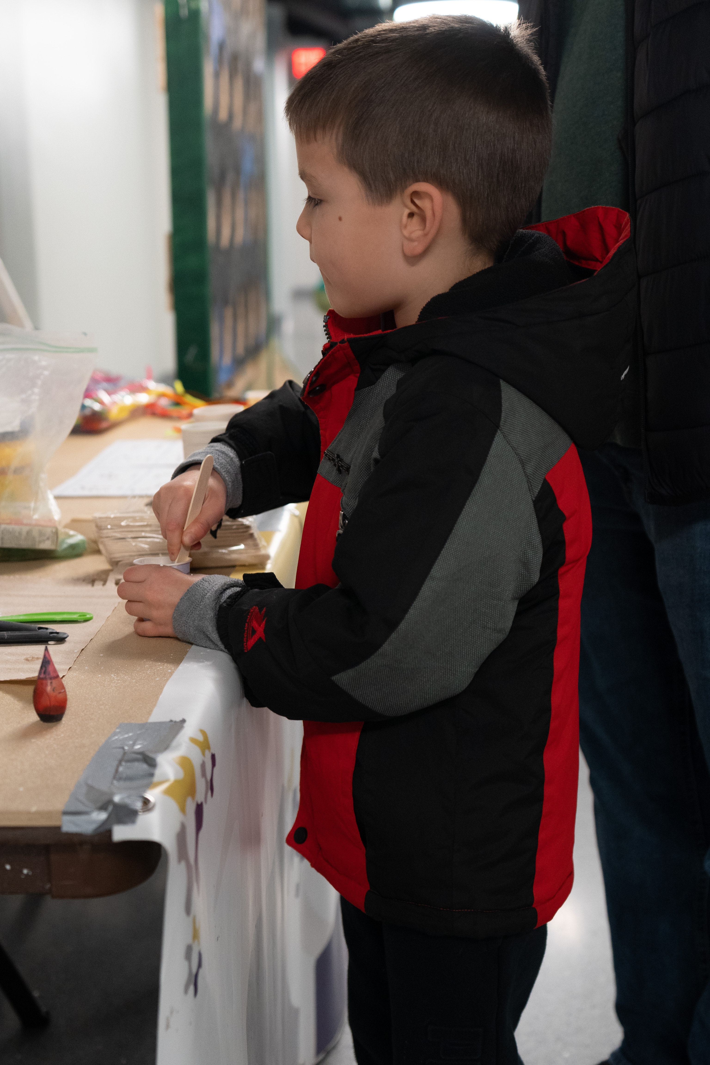
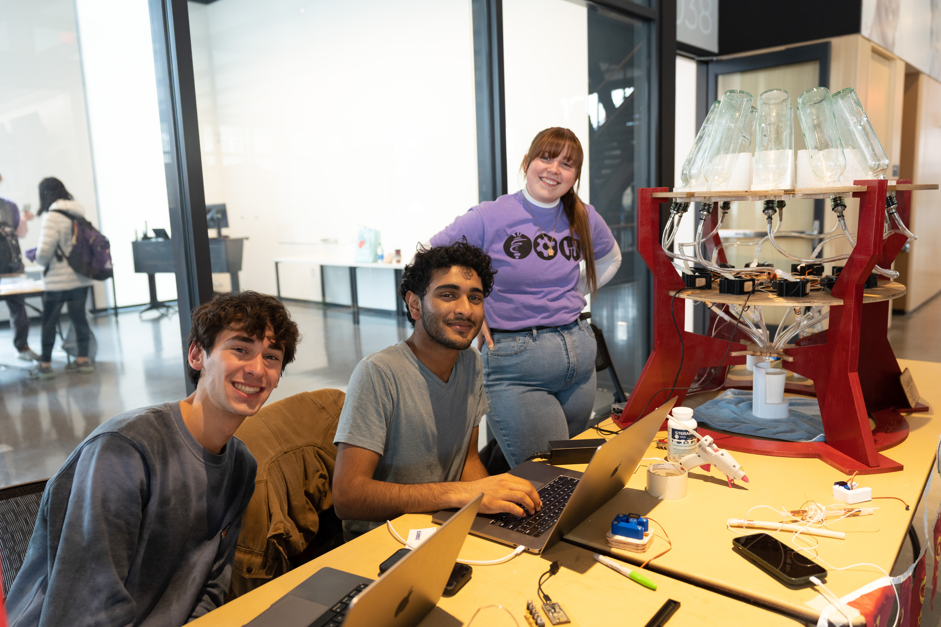
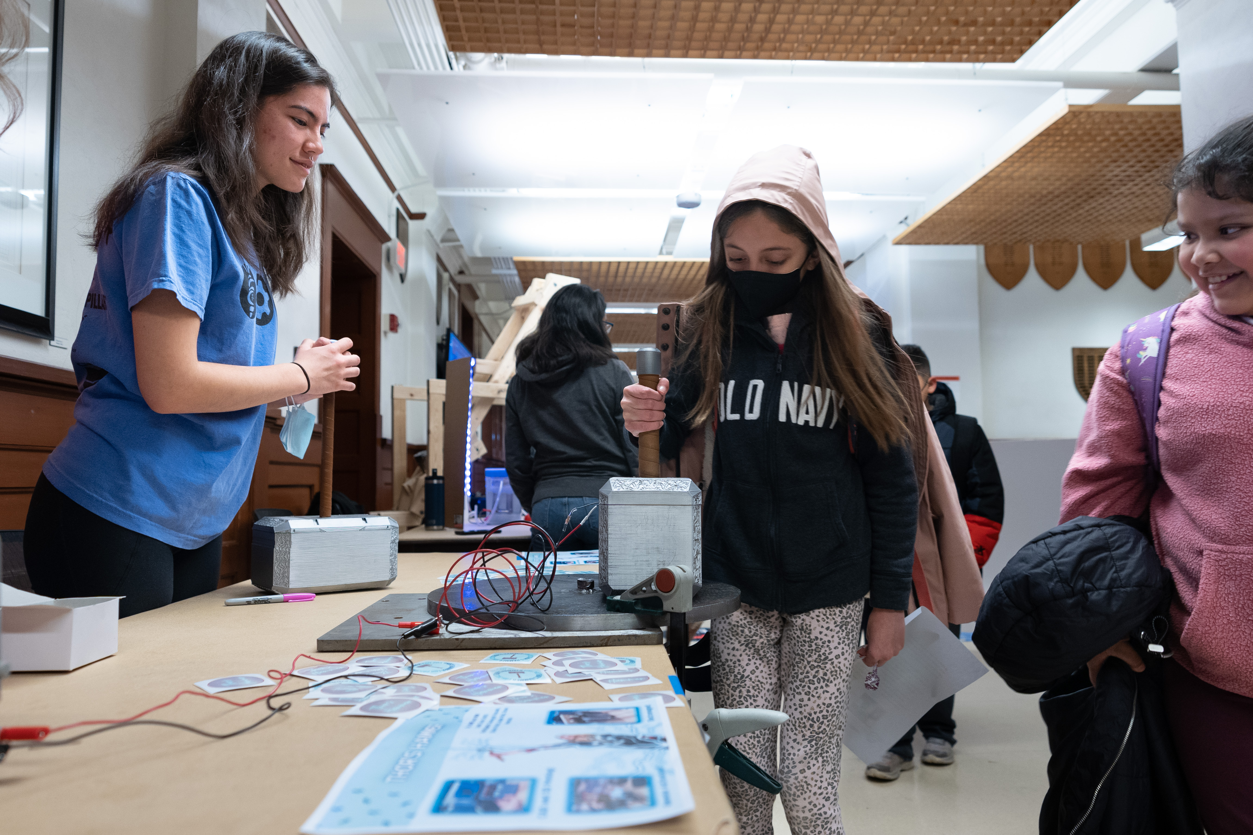
EOH 2022: Power of Us

Slide 5
Awards Category
Outstanding Freshman Exhibit
Power of Us (Theme Award)
Outstanding RSO Exhibit
Most Engaging
The Spirit of Innovation
Outstanding Tech Exhibit
Outstanding Undergraduate Research

Slide 6
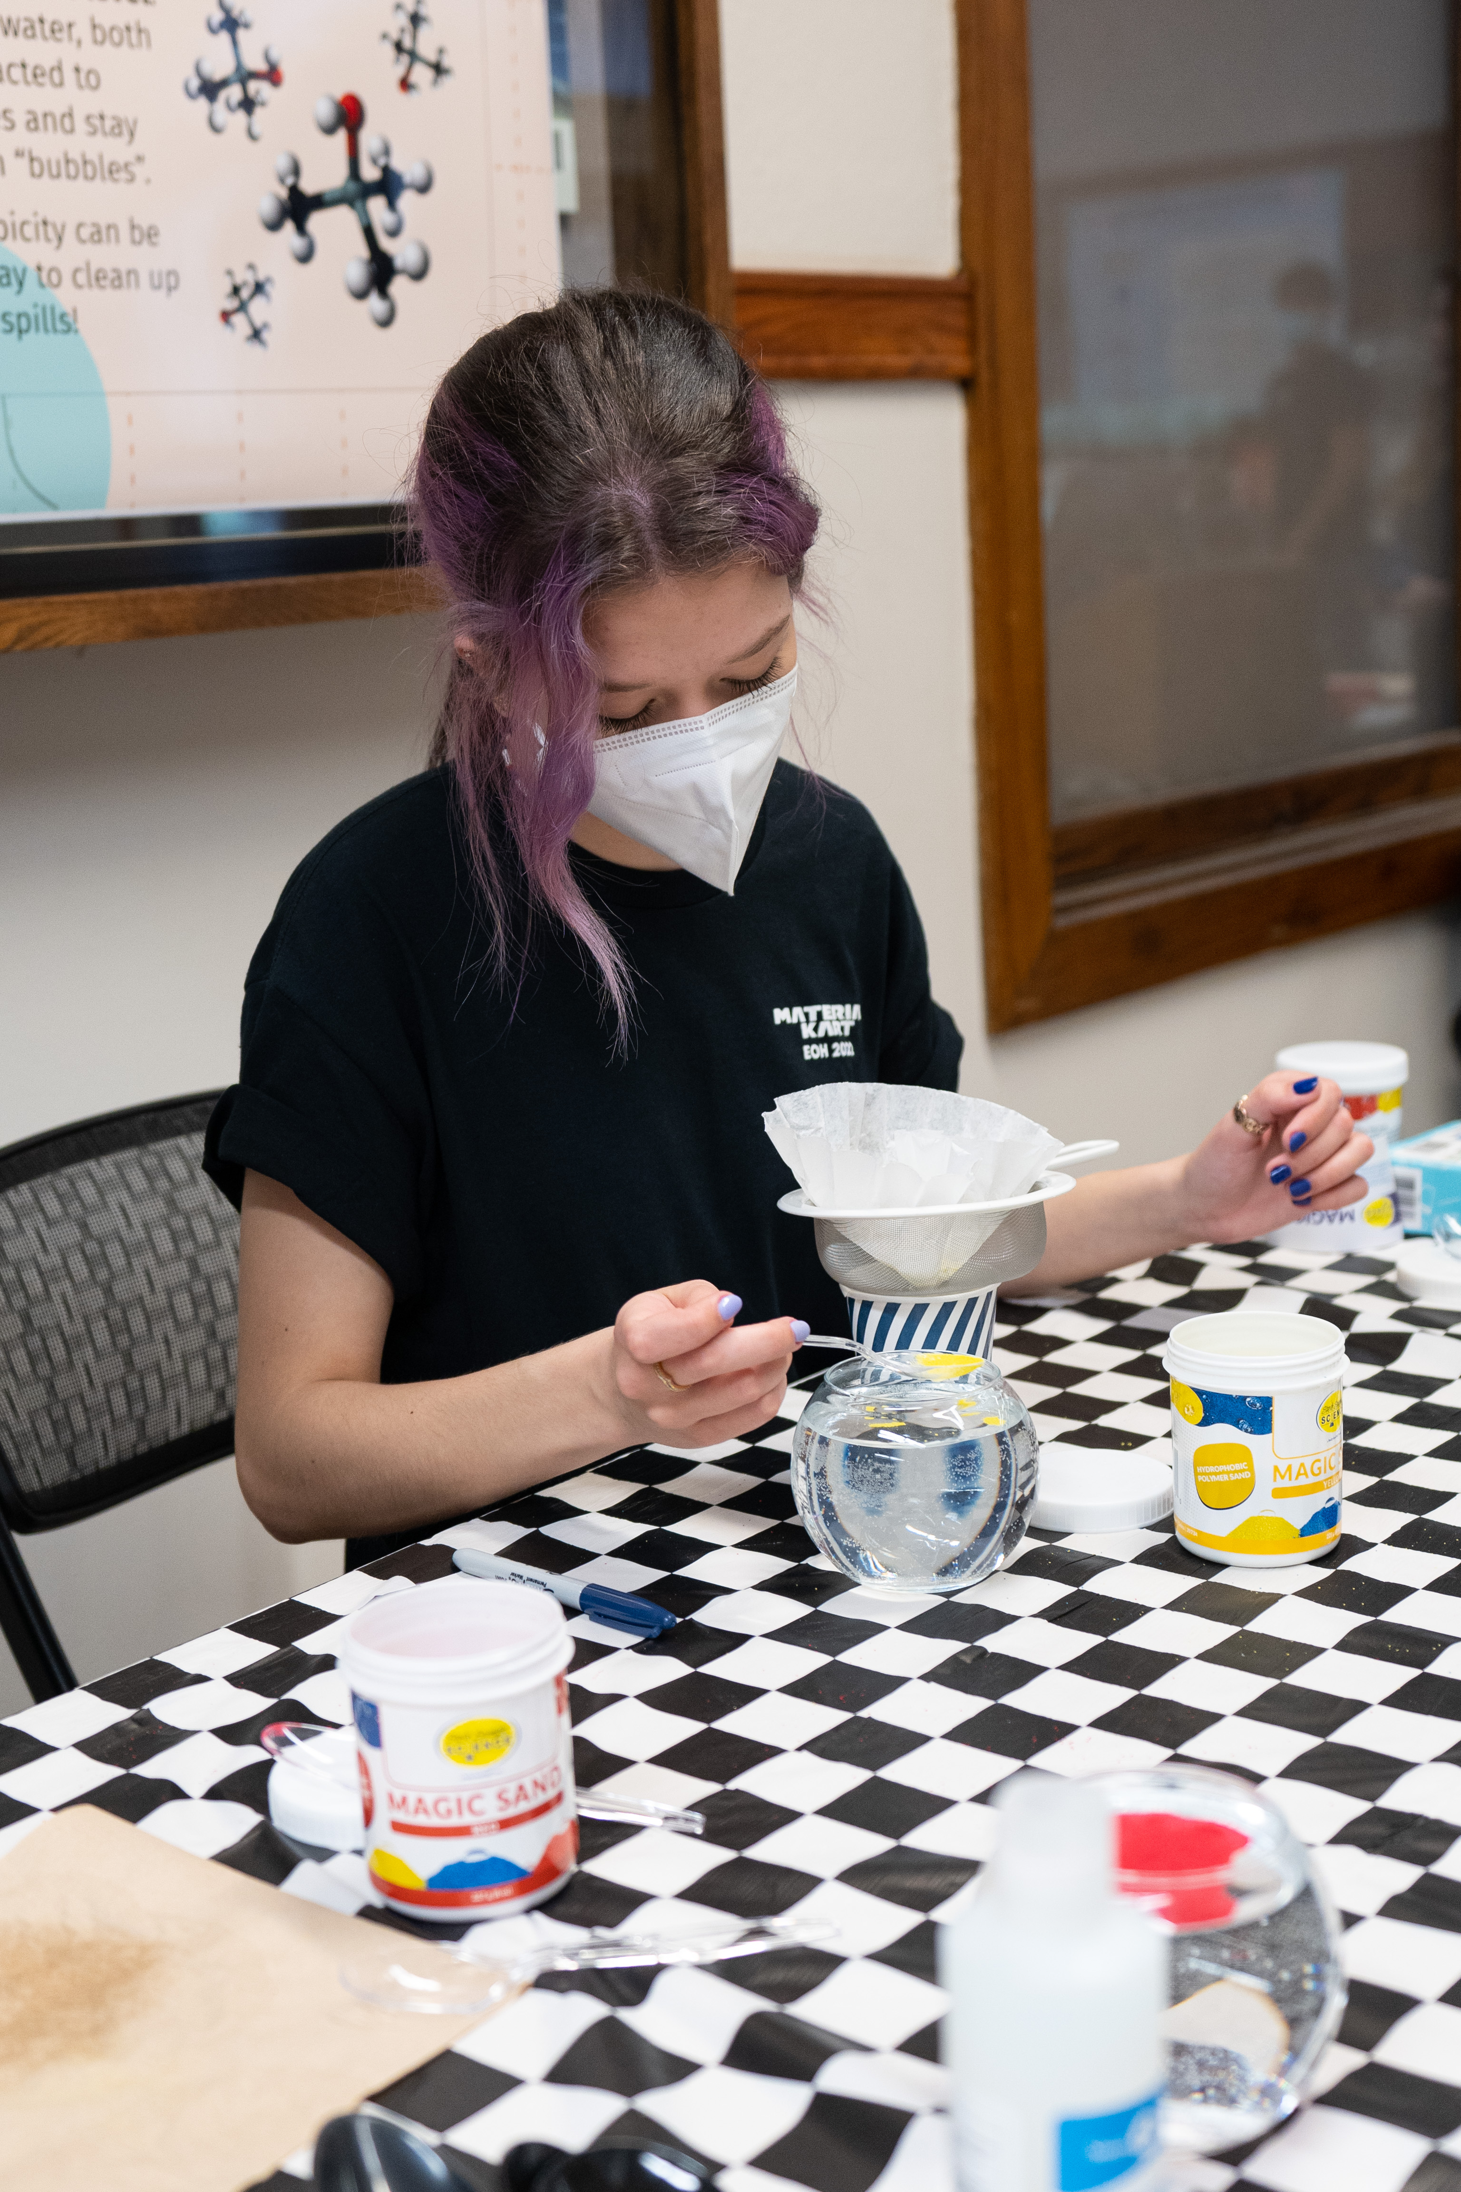
Outstanding Undergraduate Research

Slide 7
3rd Place
A Soft Robotic Hand and Arm Controlled with XR Technology

Slide 8
2nd Place
Center for AI Innovation

Slide 9
1st Place
Lassi Illini-Sat-0

Slide 10
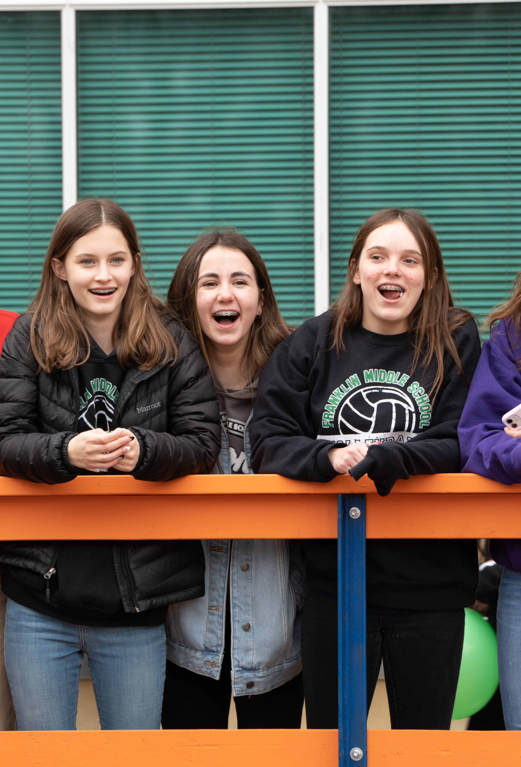
Outstanding Freshman Exhibit

Slide 11
3rd Place
Egg Drop Challenge

Slide 12
2nd Place
American Sign Language Translator Glove

Slide 13
1st Place
Supply Chain Maze

Slide 14
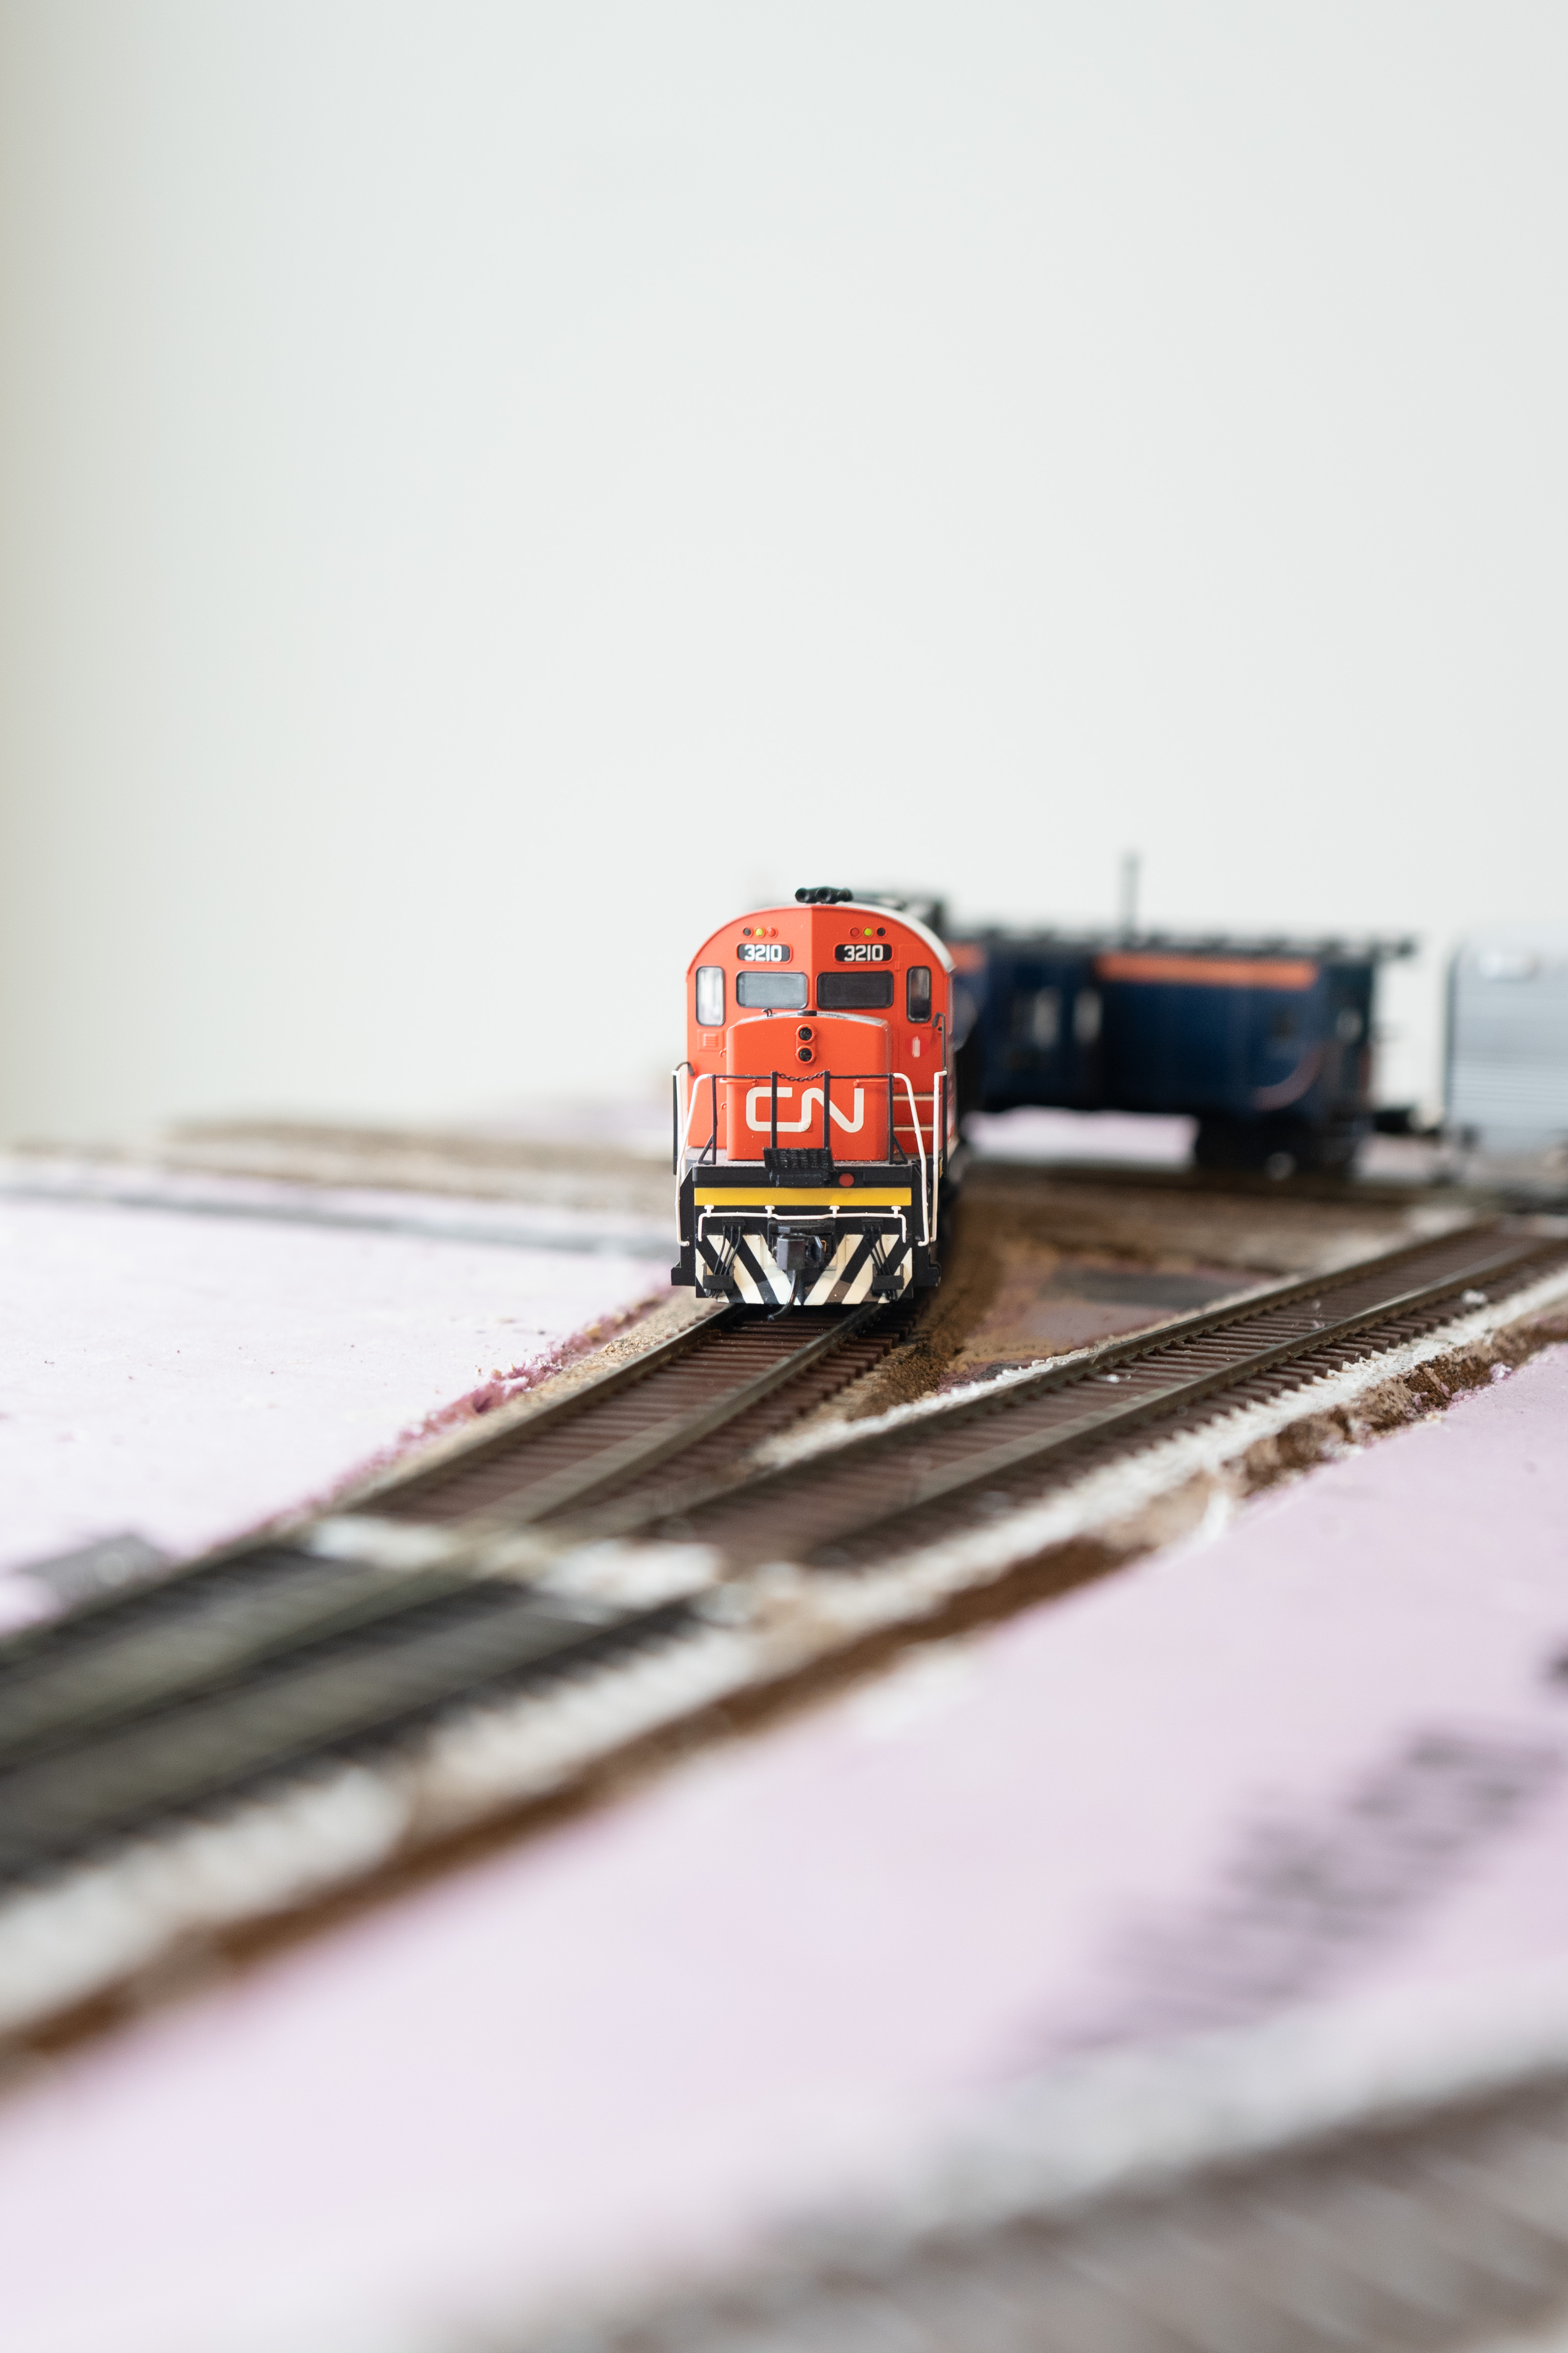
Power of Us

Slide 15
3rd Place
Robotic Hand with Speech Recognition

Slide 16
2nd Place
Rock Identification

Slide 17
1st Place
Engineers in Action Bridge Program
Learn how to use surveying equipment and find out how steeply the ground slopes

Slide 18
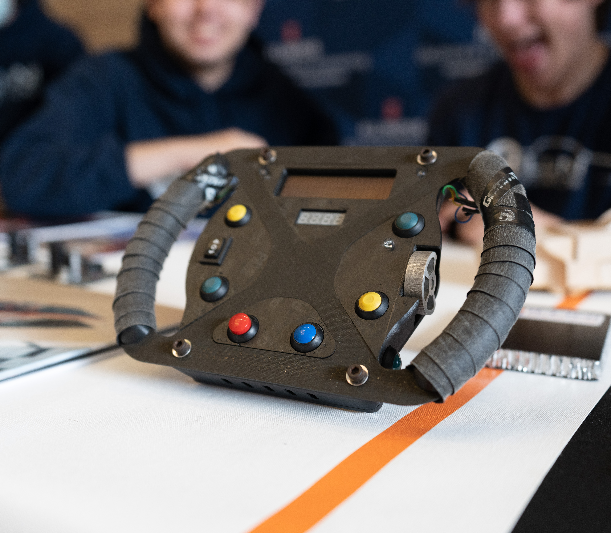
Outstanding RSO Exhibit

Slide 19
3rd Place
Off-road Illini Baja SAE Car

Slide 20
2nd Place
FSAE Illini Motorsports

Slide 21
1st Place
It’s Not Rocket Science

Slide 22
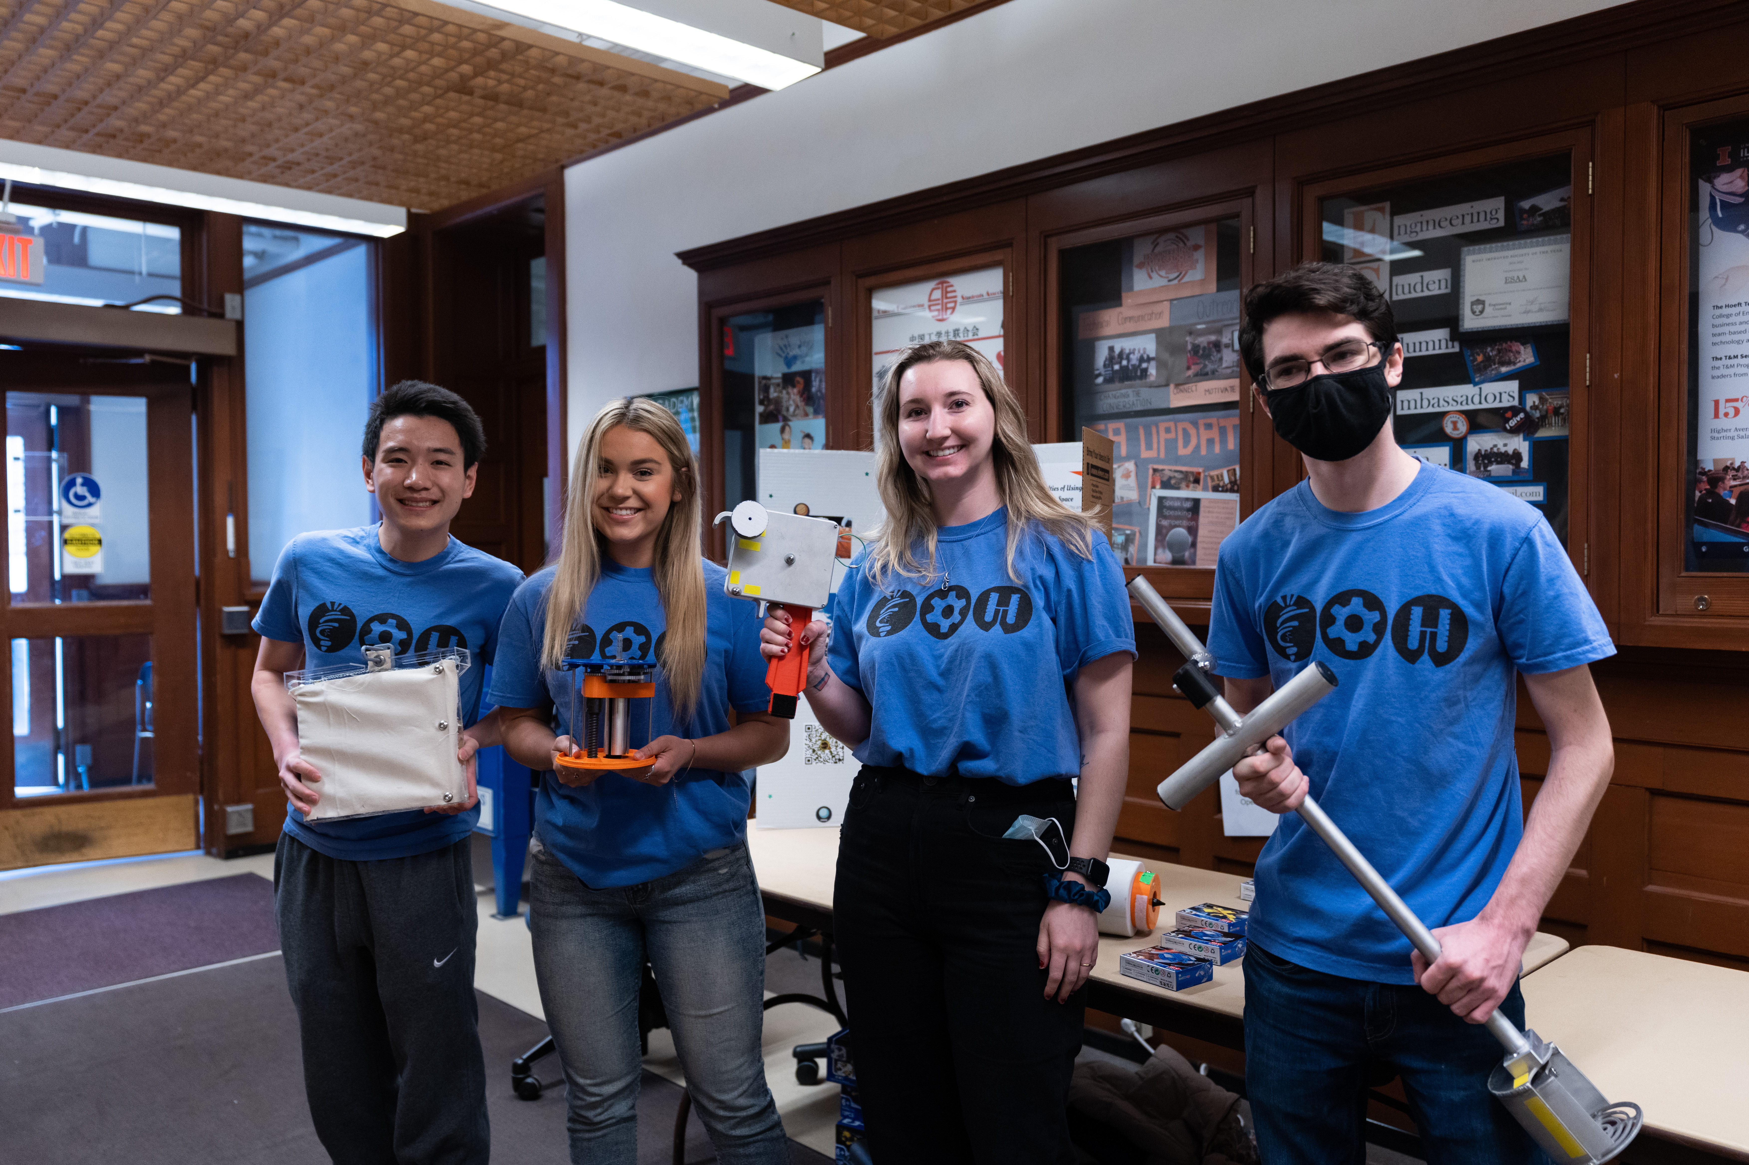
Most Engaging

Slide 23
3rd Place
Engineers in Action Bridge Program
Learn how to use surveying equipment and find out how steeply the ground slopes

Slide 24
2nd Place
It’s Not Rocket Science

Slide 25
1st Place
GRAIC
Generalized RAcing Intelligence Competition

Slide 26
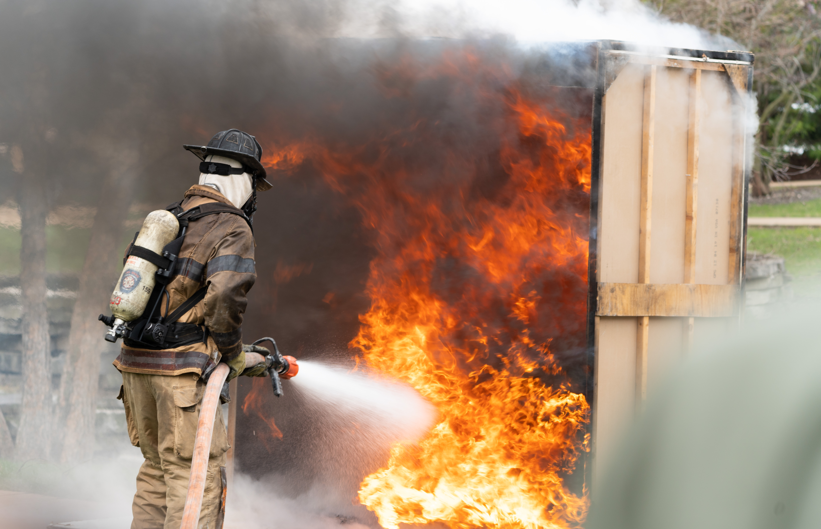
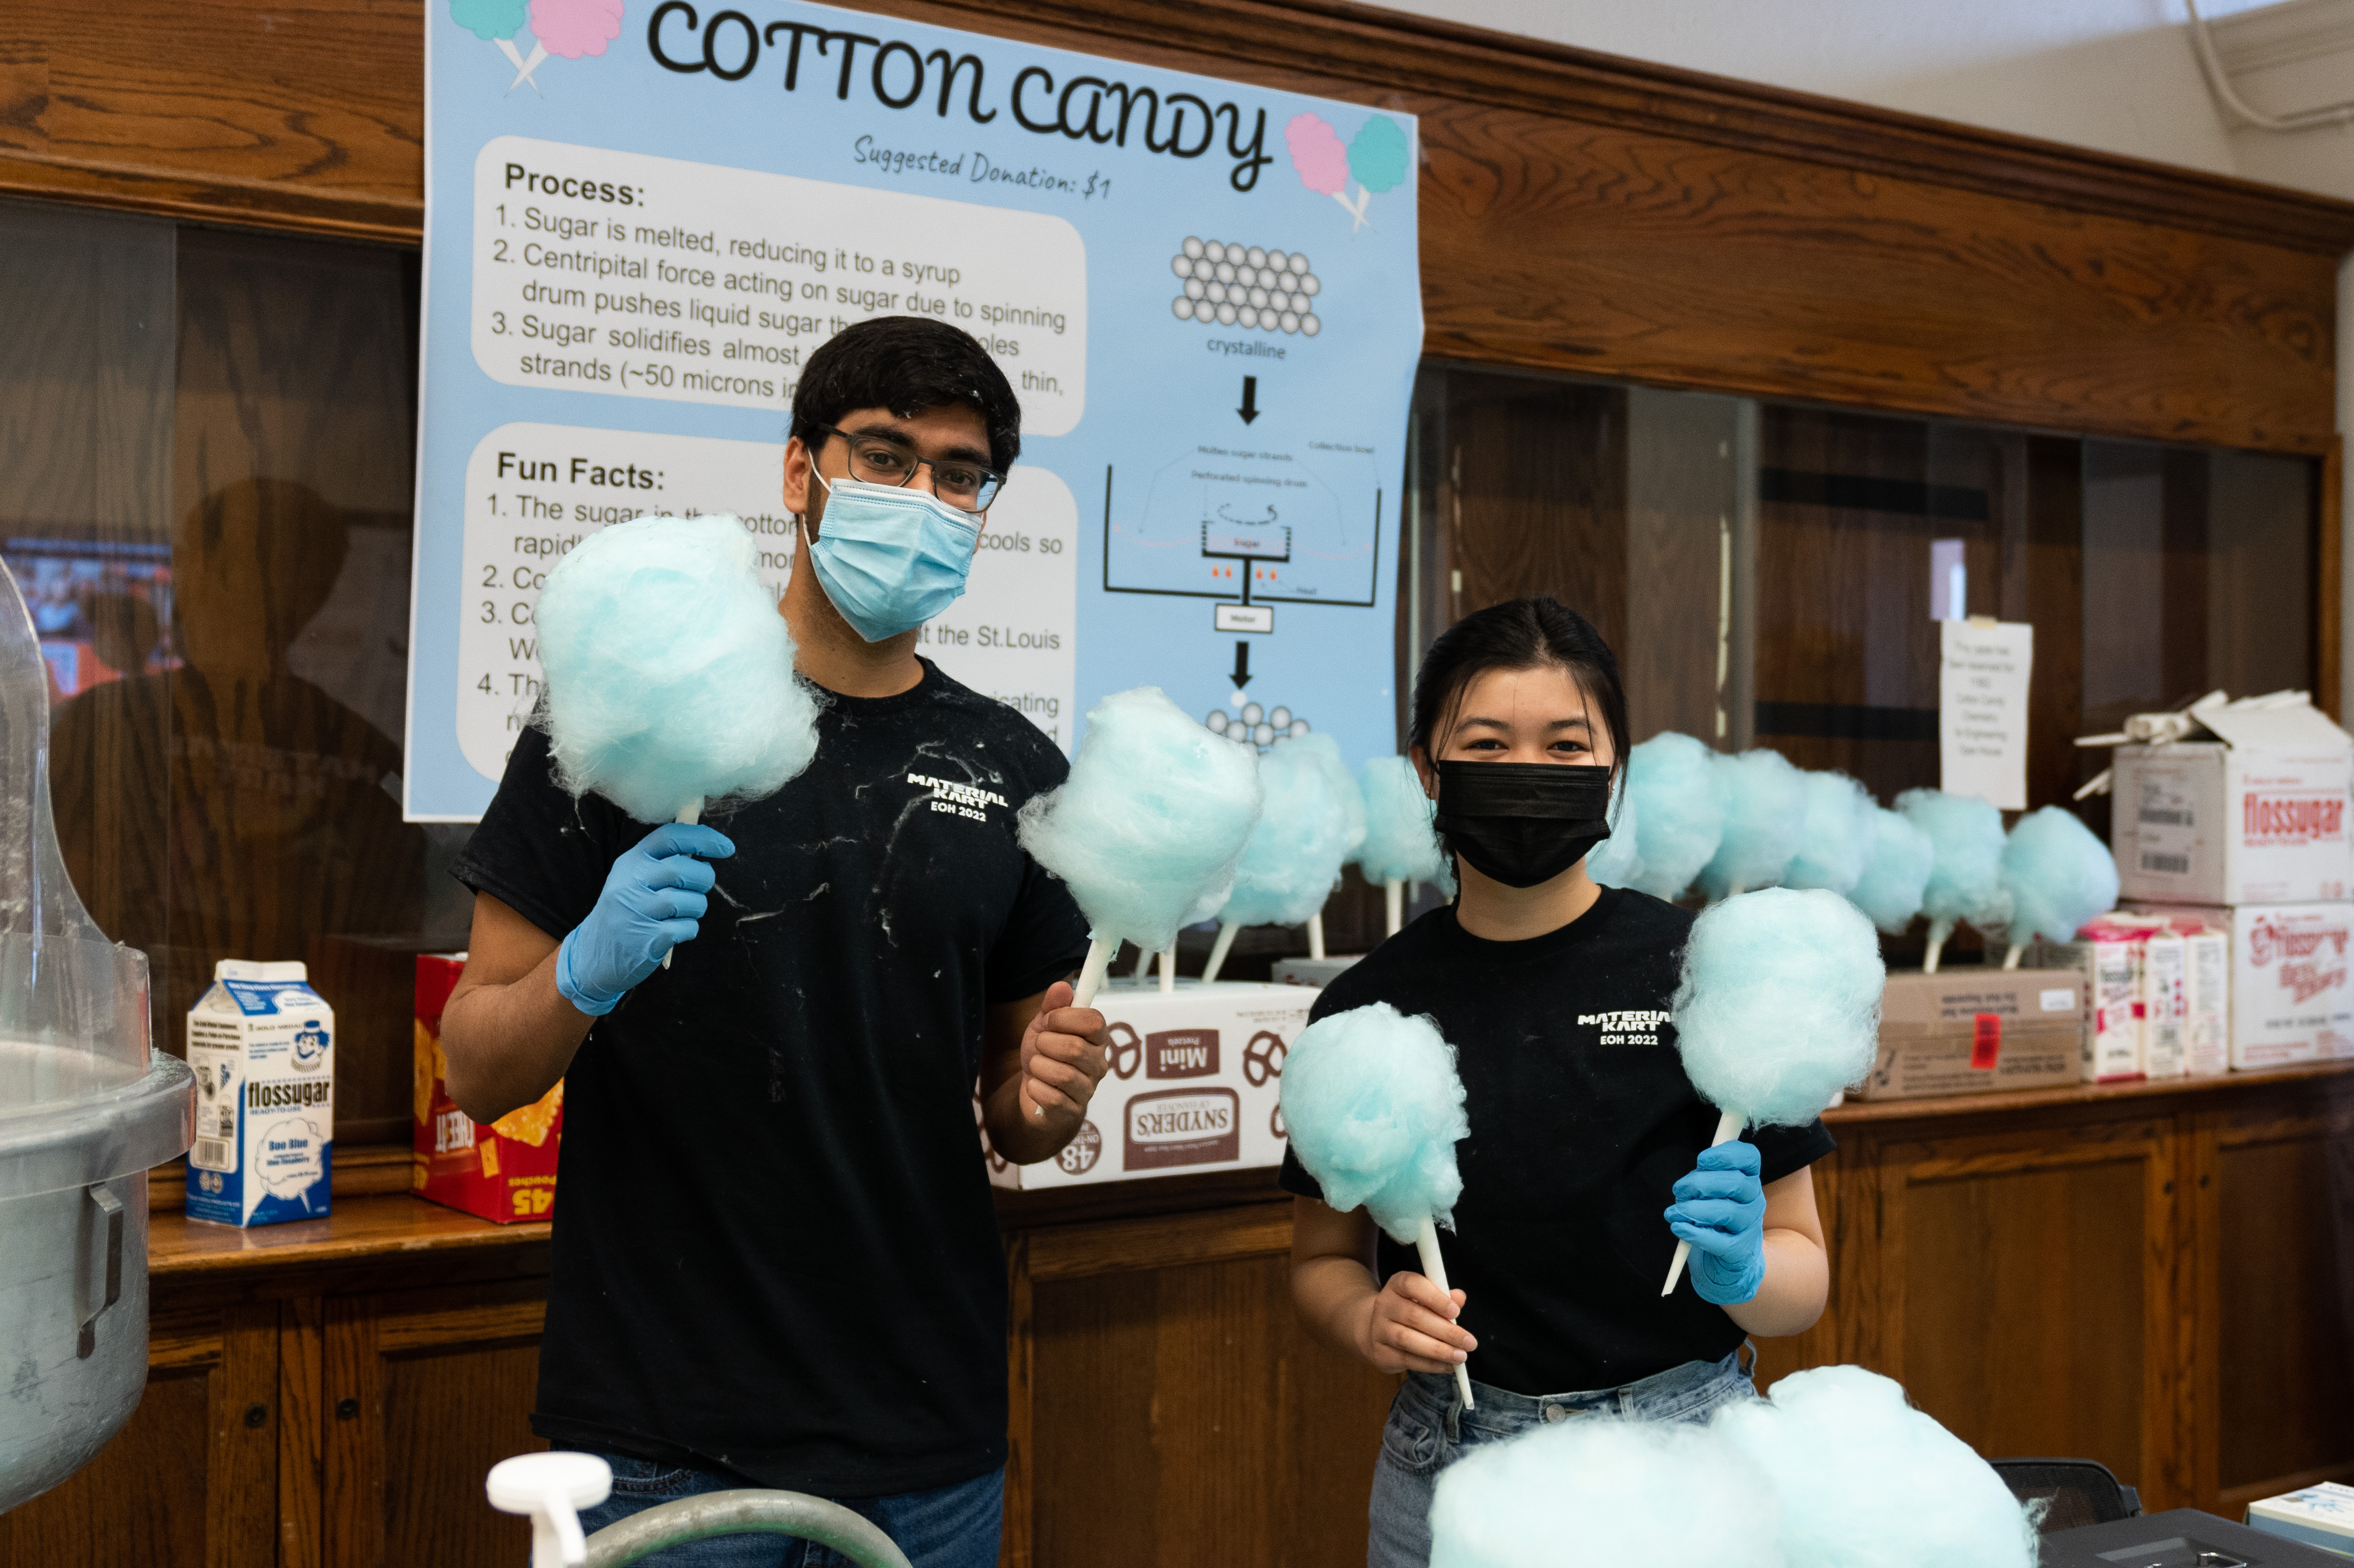
The Spirit of Innovation

Slide 27
3rd Place
FSAE Illini Motorsports

Slide 28
2nd Place
Life of Asphalt

Slide 29
1st Place
GRAIC
Generalized RAcing Intelligence Competition

Slide 30
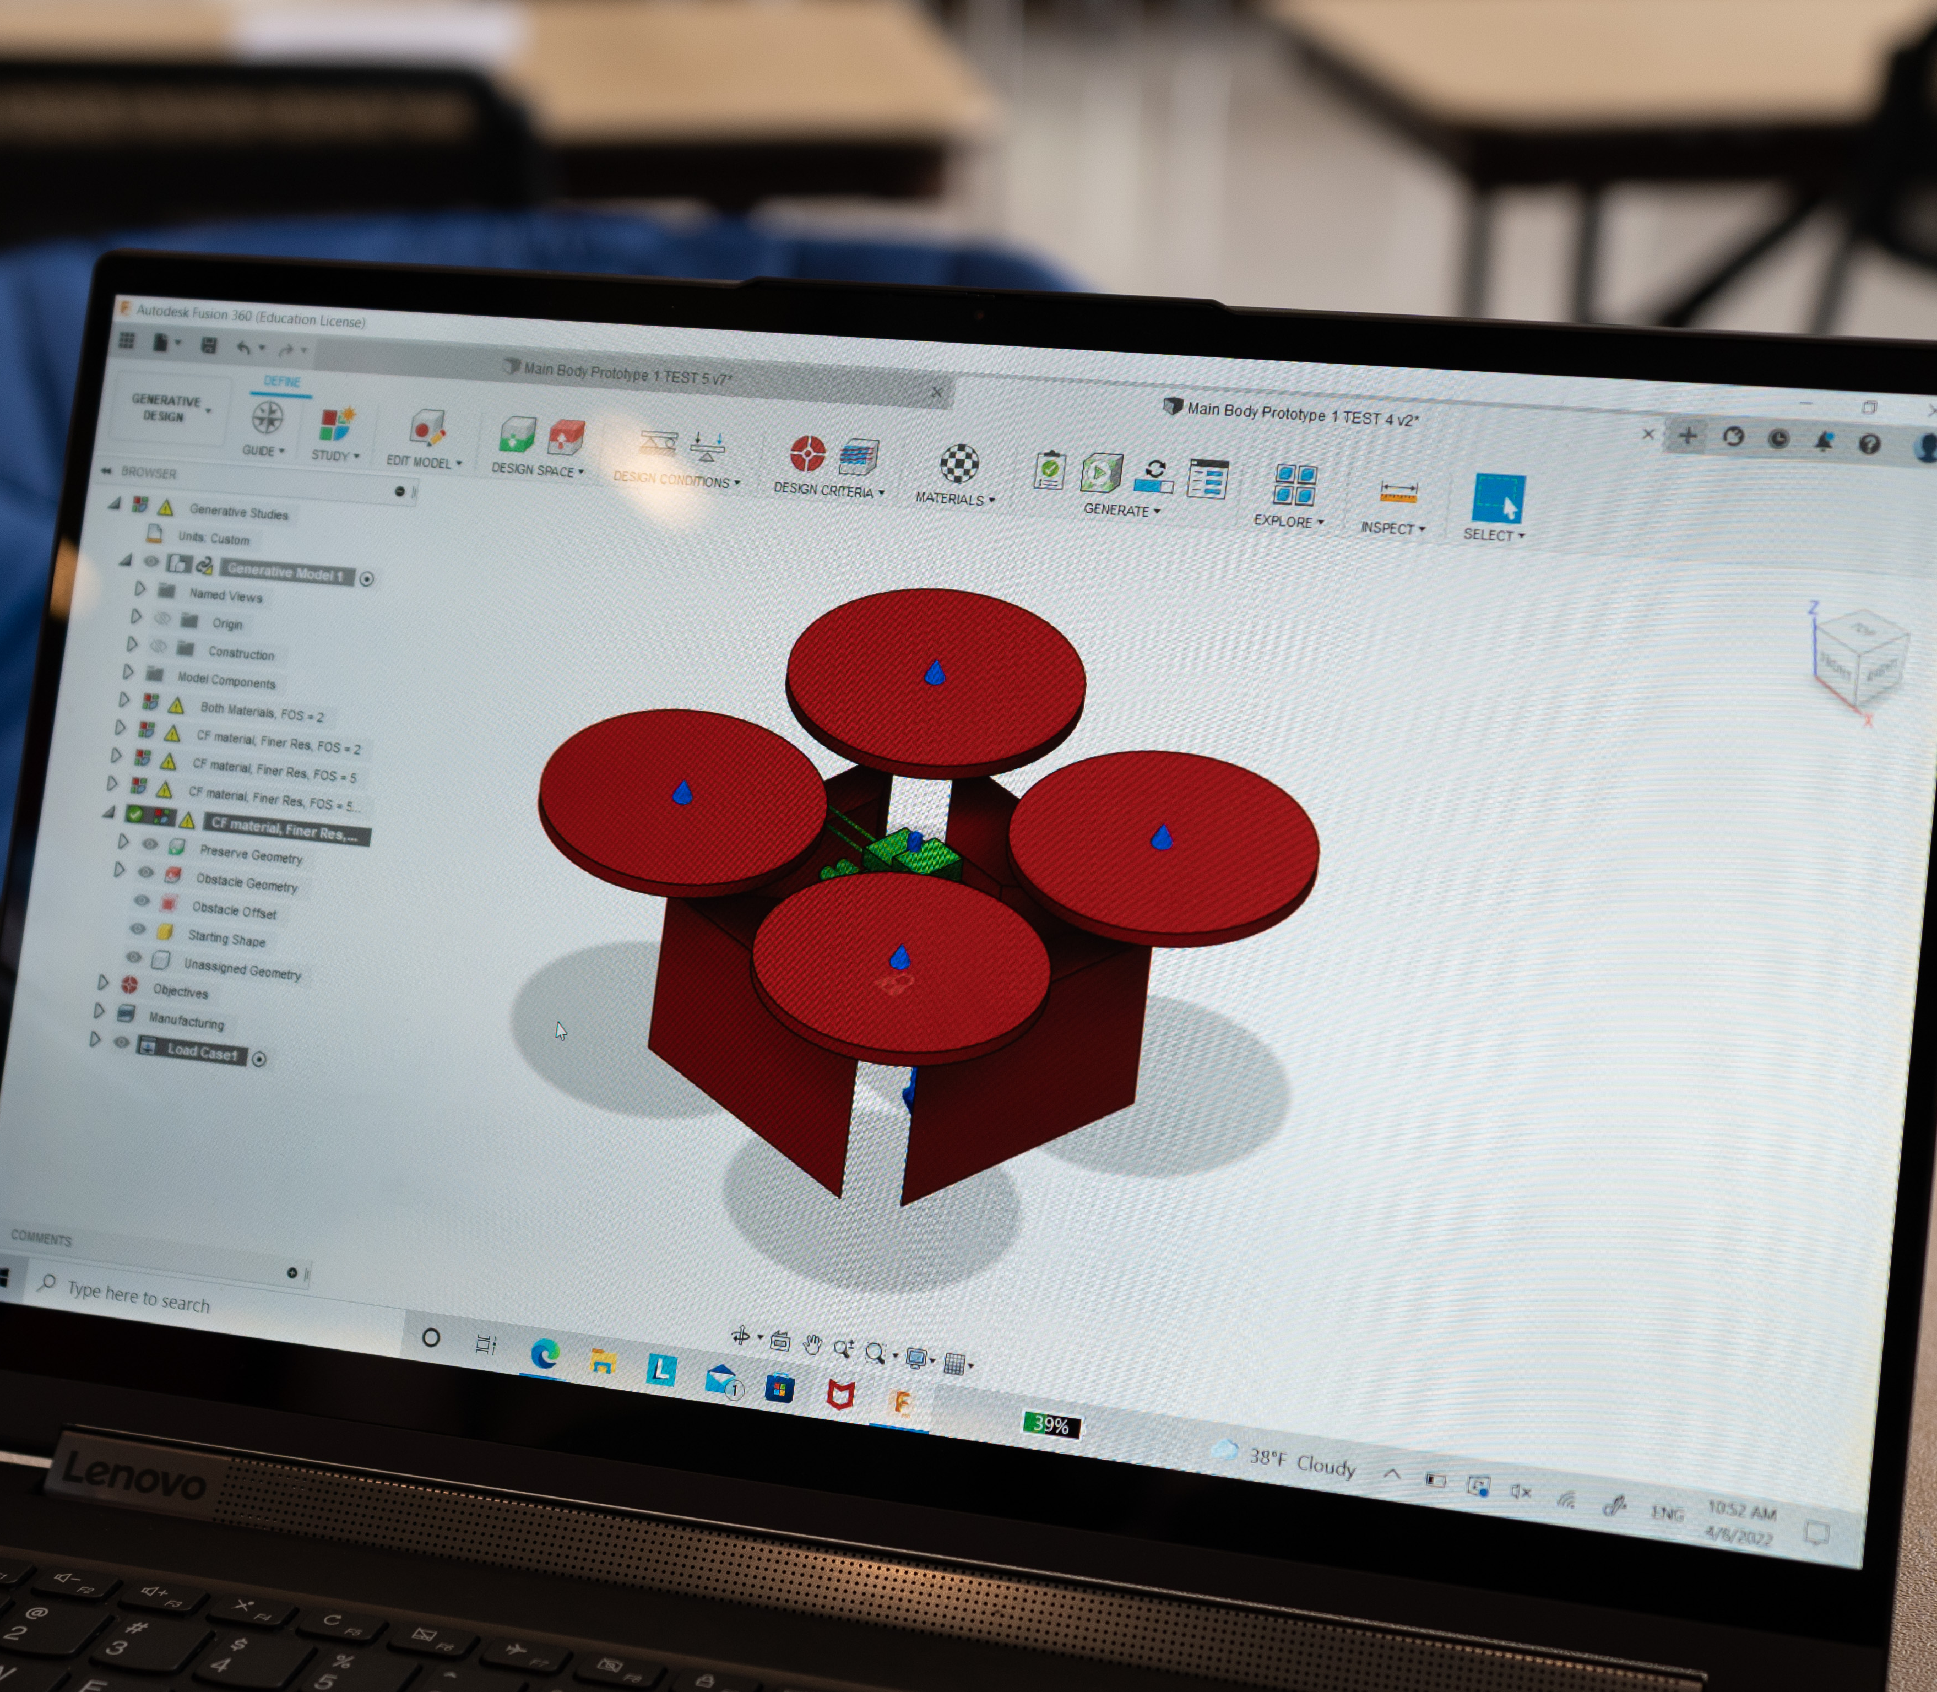
Outstanding Tech Exhibit

Slide 31
3rd Place
Blastoff

Slide 32
2nd Place
GRAIC
Generalized RAcing Intelligence Competition

Slide 33
1st Place
It’s Not Rocket Science

